Slide 1

INDOOR SCENE UNDERSTANDING IN 2.5RGB-D AND 3D
A Survey: on Computer Vision
Presented by Varun Bhaseen

Slide 2
INDOOR SCENE UNDERSTANDING IN 2.5RGB-D AND 3D
Authored by:
Hongwei Yong, Jianqiang Huang, Xiansheng Hua, Lei Zhang
Date Published:
10 January 2019
Article Link:
https://arxiv.org/abs/1803.03352

Slide 3
Introduction
An image to a machine can be represented as nothing but a grid of numbers.
In order to develop a model which has a comprehensive understanding of visual content, it is necessary to uncover the underlying geometric and semantic clues between various scene elements present in its field of vision.
It is also required to comprehend both the apparent and hidden relationships present between scene elements.

Slide 4
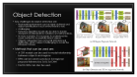
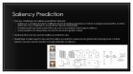

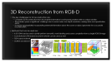



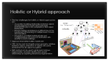
Approach for Computer Vision Modelling
Image Recognition
Object Detection
Semantic Segmentation
Physics based reasoning
Object pose estimation
3d reconstruction from RGB-D
Saliency Prediction
Holistic or hybrid approach

Slide 5
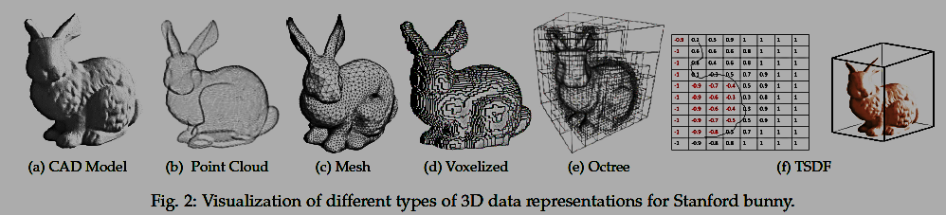
Data Representation
Point Cloud
Voxel Representation
3d Mesh
Depth Channel and Encodings
Octree representation
Stixels
Truncated Signed Distance function
Constructive Solid Geometry

Slide 6
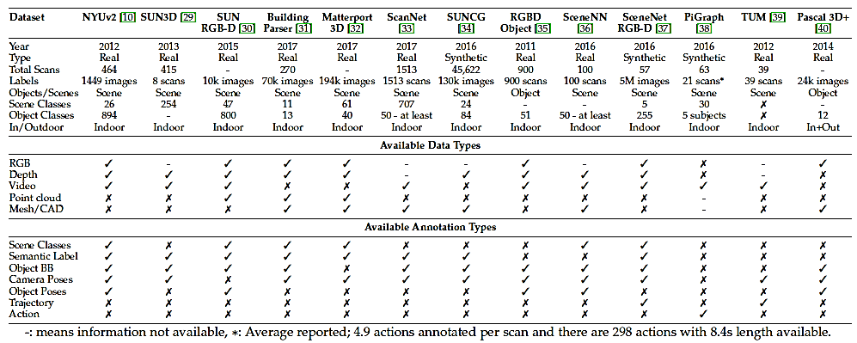
Datasets: List of popular datasets

Slide 7
Thank you
Article Link: https://medium.com/@varun.bhaseen/an-approach-for-computer-vision-indoor-scene-understanding-in-2-5rgb-d-and-3d-b77a133574a0

Slide 8
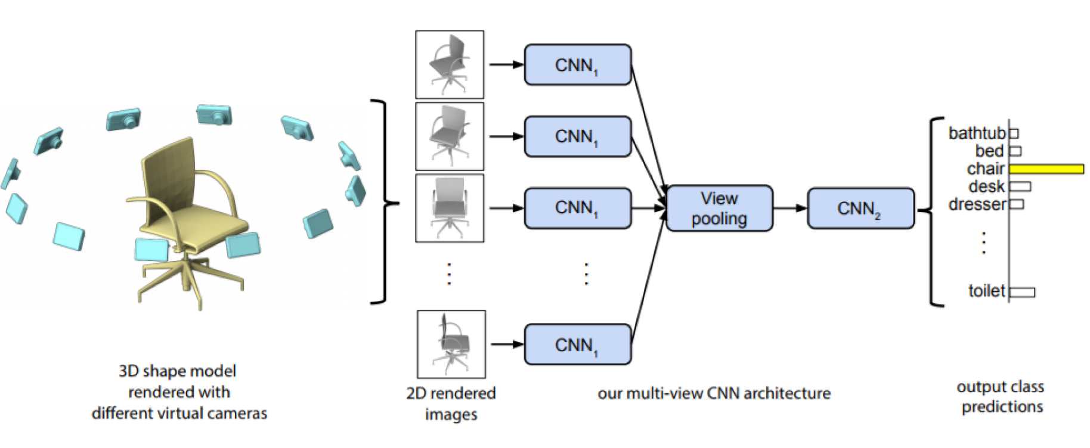
Image Recognition
The key challenges in image recognition are:
2.5/3D data can be represented in multiple ways as discussed above. Challenge then is to choose the data representation that provides maximum information with minimum computational complexity.
A key challenge is to distinguish between fine grained categories and appropriately model intraclass variations.
Designing algorithms that can handle illuminations, background clutter and 3D deformations.
Designing algorithm that can learn from limited data
Method that can be used:
Multi View CNN for recognizing 2d views from 3d views then VGG-M network was fine-tuned on rendered views
gPb-ucm for hierarchical image segmentation and SVM as classifier
Convolutional deep belief network (DBN)
3D-GAN for 3D object generation and recognition

Slide 9
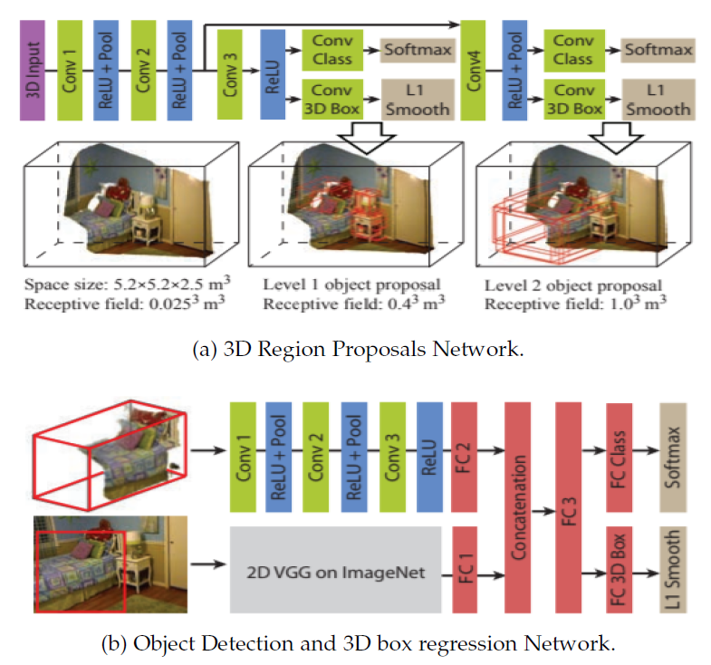
Object Detection
Key challenges for object detection are:
Real world environments can be highly cluttered and object identification in such environments is very
challenging.
Detection algorithm should also be able to handle viewpoint and illuminations variations and deformations.
In many scenarios, it is necessary to understand the scene context to successfully detect objects.
Objects categories have a long-tail (imbalanced) distribution, which makes it challenging to model the infrequent classes
Methods that can be used are:
A CRF model can be used to model relationship between objects and regions
RPN can be used to produce 3d regional proposal followed by 3d & 2d CNN
Fast R-CNN can also be used.

Slide 10
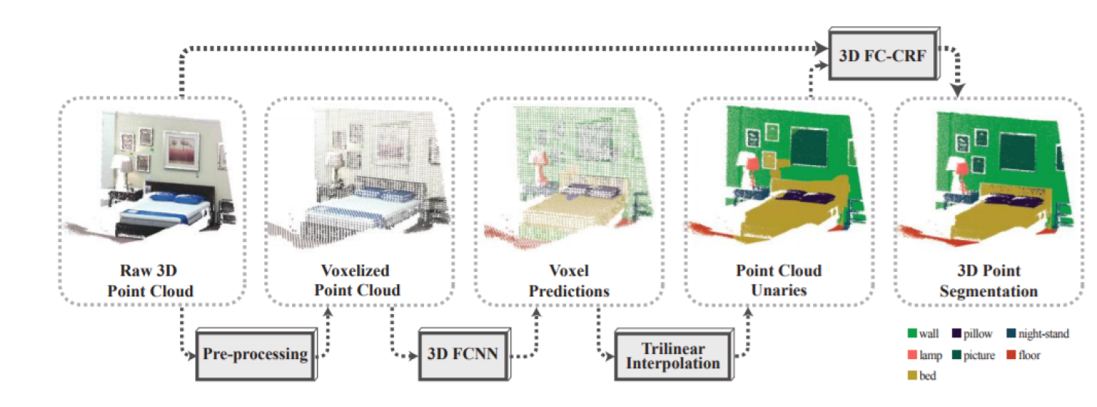
Semantic Segmentation
The key challenges for semantic segmentation is :
Pixel level labeling requires both local and global information and challenge then is to design such algorithms that can incorporate the wide contextual information together.
The difficulty level increases a lot for the case of instance segmentation, where the same class is segmented into different instances.
Obtaining dense pixel level predictions, especially close to object boundaries, is challenging due to occlusions and confusing backgrounds.
Segmentation is also affected by appearance, viewpoint, and scale changes
Methods that can be used:
CRF is the usual choice for semantic segmentation
Multi-scale convolutional neural networks (MCNN)
R-CNN
FCN
Also combination of both CNN and CRFs for improved segmentations

Slide 11
Physics based reasoning
The key challenges that has been faced for physics-based reasoning is:
This task requires starting with extremely limited information (e.g., a still image) and performing extrapolation to predict rich information about scene dynamics.
A desirable characteristic is to adequately model prior information about the physical world.
Physics based reasoning requires algorithms to reason about the contextual information
Can be subdivided into multiple areas like:
Dynamics prediction
Support relationships
Stability Analysis
Hazard detection
Occlusion reasoning

Slide 12
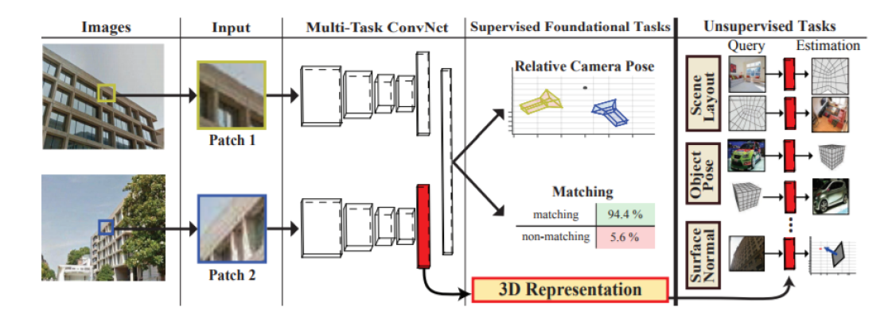
Object pose estimation
The key challenges for pose estimation algorithms encounter are:
The requirement of detecting objects and estimating their orientation at the same makes this task particularly challenging.
Object’s pose can vary significantly from one scene to another; therefore algorithm should be invariant to these changes.
Occlusions and deformations make the pose estimation task difficult especially when multiple objects are simultaneously present
Methods that can be used are as:
Latent-Class Hough Forests
CNN trained with a probabilistic approach to find the best pose hypothesis
AlexNet (Large CNN)

Slide 13
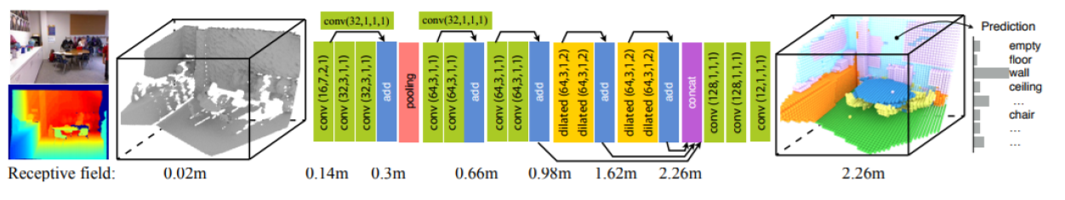
3D Reconstruction from RGB-D
The key challenges for 3D reconstruction are:
Complete 3D reconstruction from incomplete information is an ill-posed problem with no unique solution.
This problem poses a significant challenge due to sensor noise, low depth resolution, missing data and quantization errors.
It requires appropriately incorporating external information about the scene or object geometry for a successful reconstruction
Methods that can be used are:
A 3D CNN can be used to jointly perform semantic voxel labeling and scene completion from a single RGB-D image
Convolutional LSTM based recurrent network can be used as well
TSDF based network
OctNet and SSCnet

Slide 14
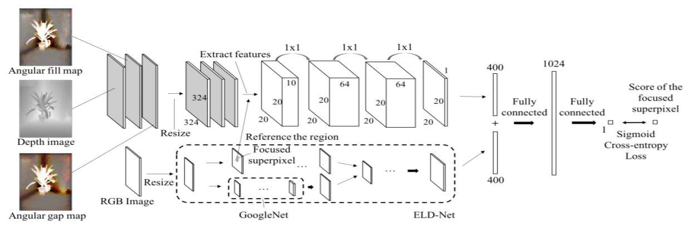
Saliency Prediction
The key challenges for saliency prediction task are:
Saliency is a complex function of different factors including appearance, texture, background properties, location, depth etc. It is a challenge to model these intricate relationships.
It requires both top-down and bottom-up cues to accurately model objects saliency.
A key requisite is to adequately encode the local and global context
Methods that can be used for Saliency prediction are:
Multistage models need to be used for saliency prediction where local, global and background contrast-based cues are used to predict a rough estimate of saliency

Slide 15
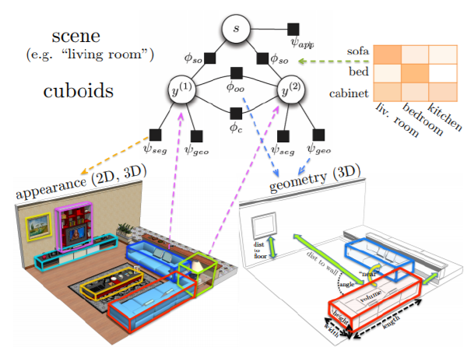
Holistic or Hybrid approach
The Key challenges for Holistic or Hybrid approaches are:
Accurately modeling relationships between objects and background is a hard task in real-world environments due to the complexity of inter-object interactions.
Efficient training and inference is difficult due to the requirement of reasoning at multiple levels of scene decomposition.
Integration of multiple individual tasks and complementing one source of information with another is a key challenge.
Approach that define holistic models are:
CRF can be used to integrate scene geometry, relations between objects, interaction of objects with scene environment for 3D object recognition
MRF method can be used to jointly learn instance segmentation, semantic labeling and support relationships by exploiting hierarchical segmentation

